Slide 1
EECE5606 – SP2024 Final Project
Low-Voltage Shunt Capacitive RF-MEMS Switch
Pavan Umesh

Slide 2
Outline
Background and Motivation
Device Overview and Fabrication Process
Device Variations
Layout Top View
Test Structures

Slide 3
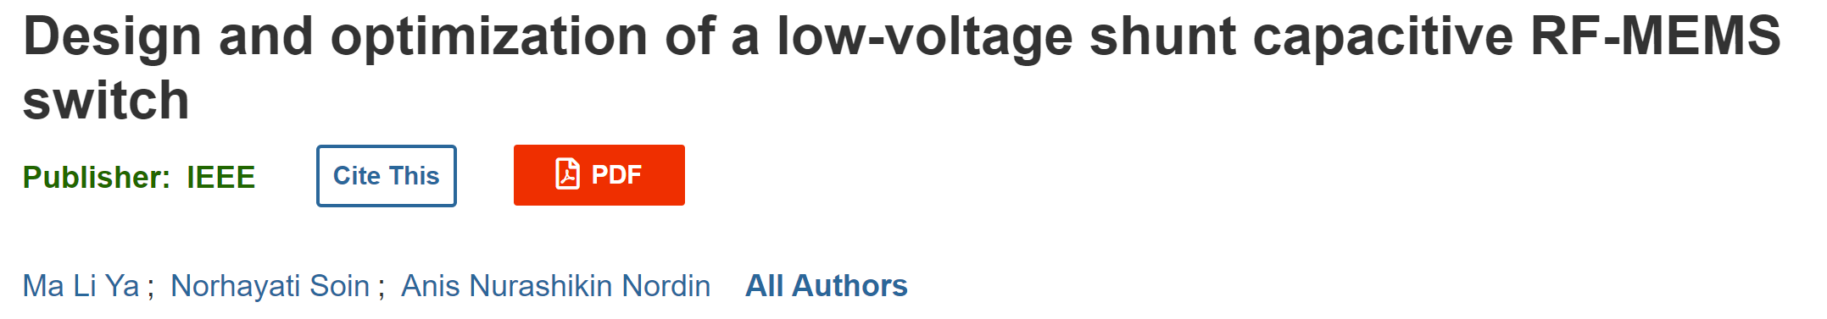
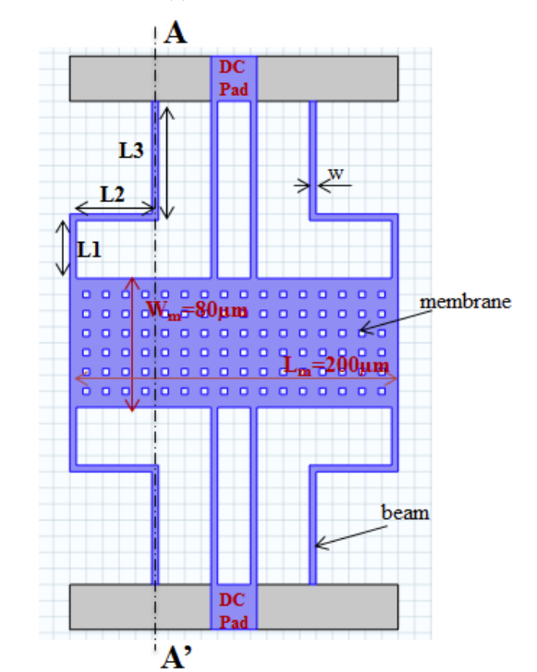
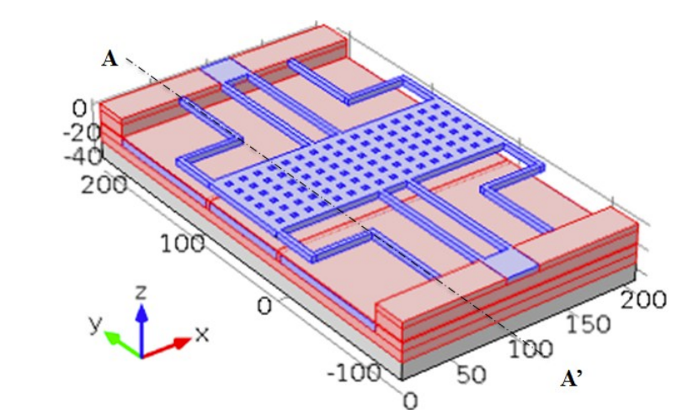
Background and Motivation

Slide 4
Background and Motivation
Traditional RF-MEMS switches operate at high voltages (20-40V), Developing a switch that operates at a low voltage (2.9V) allows seamless integration with CMOS circuits, enhancing chip size reduction and cost efficiency
RF-MEMS switches offer advantages over conventional RF switches, including lower power consumption, lower insertion losses when active, and higher isolation when inactive.
These properties make MEMS switches particularly suitable for advanced wireless communication systems.
Employed the Taguchi method for robust geometric optimization, ensuring the switch is both low-voltage and mechanically robust.
Optimized dimensions balance the mechanical stress and electrostatic forces, reducing the susceptibility to failures and improving longevity.
The successful design of a low-voltage RF-MEMS switch can lead to more compact, efficient, and cost-effective electronic devices.
Has potential implications for improving the performance and reliability of devices in telecommunications and other high-frequency application.

Slide 5

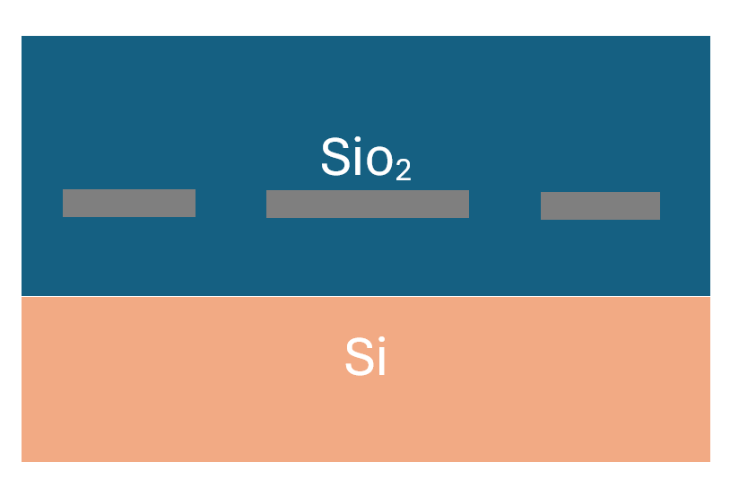
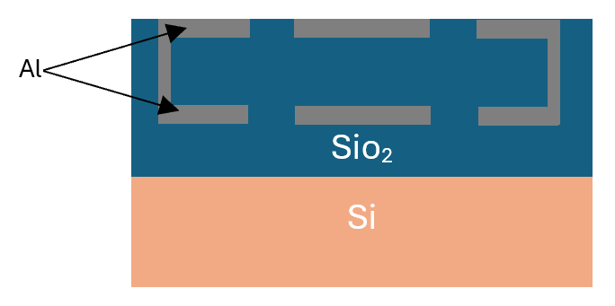
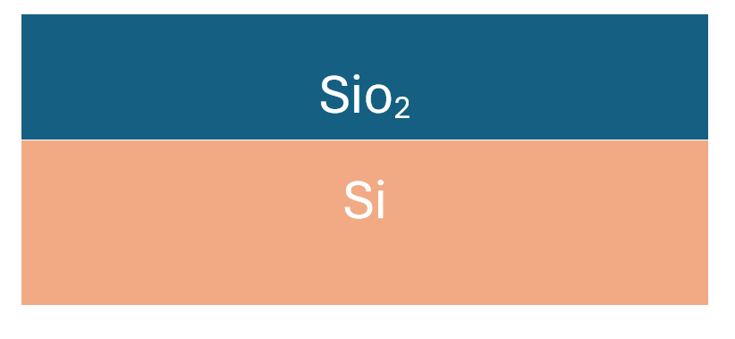
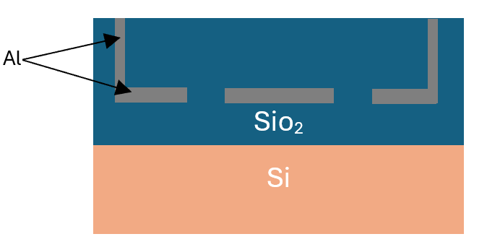
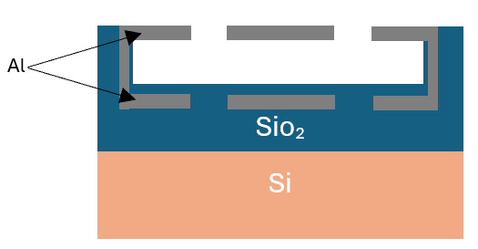

Device Overview and Fabrication Process
SiO2 deposition
Al deposition
Thermal oxidation
vias etching and
Al deposition
SiO2 etching
Al deposition

Slide 6
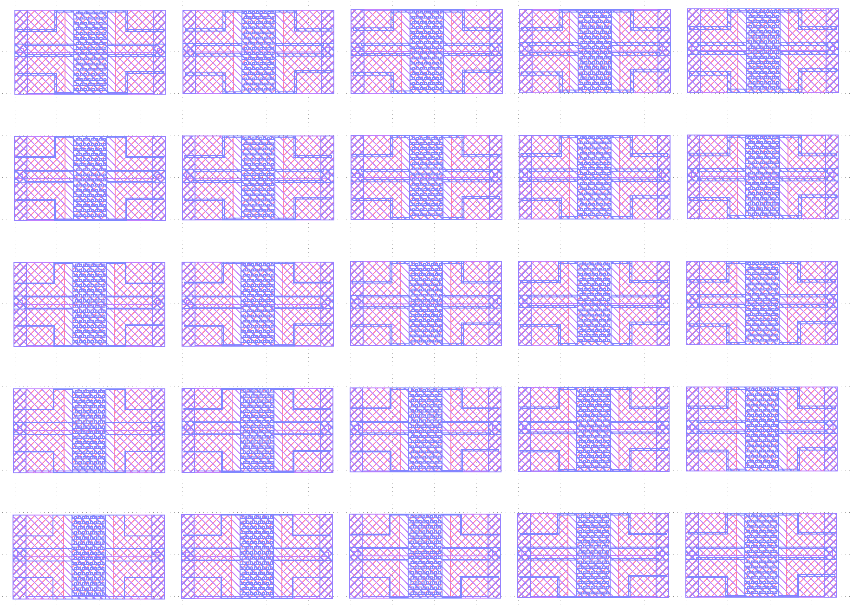
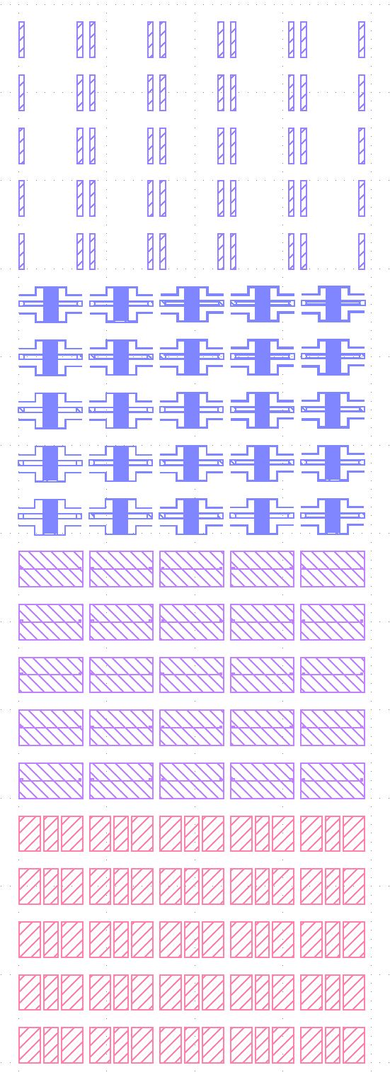
Device Variations

Slide 7
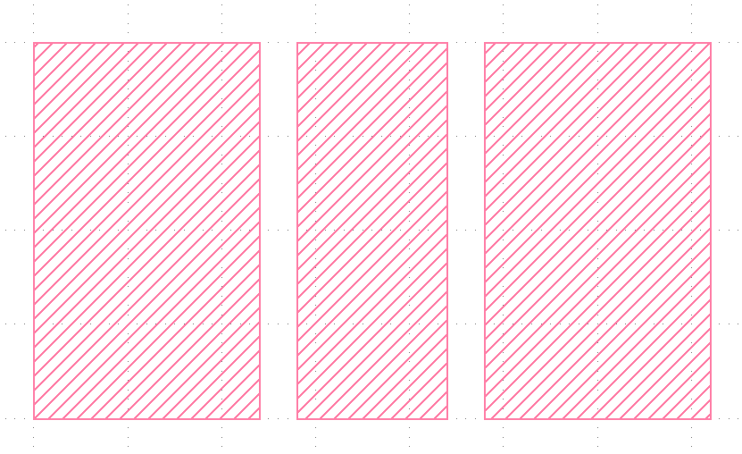
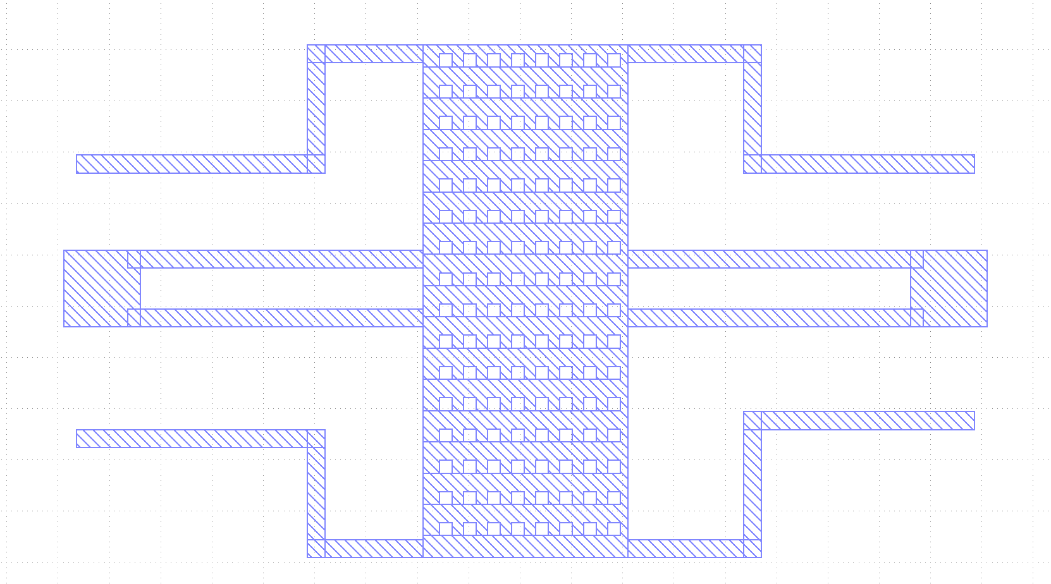
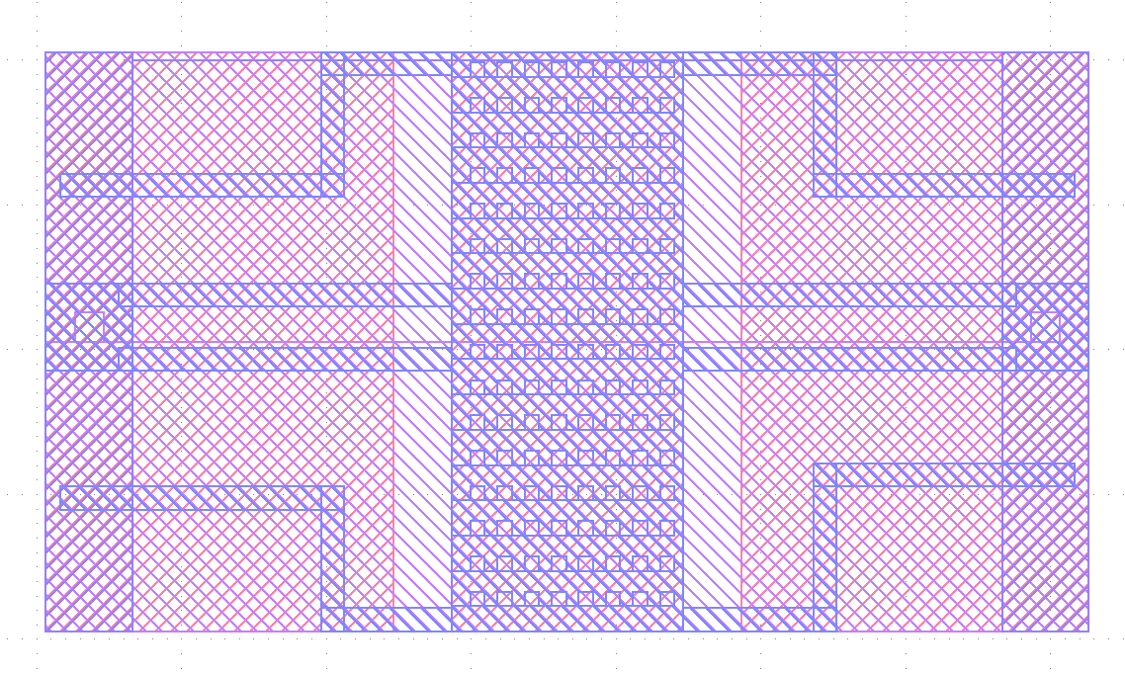

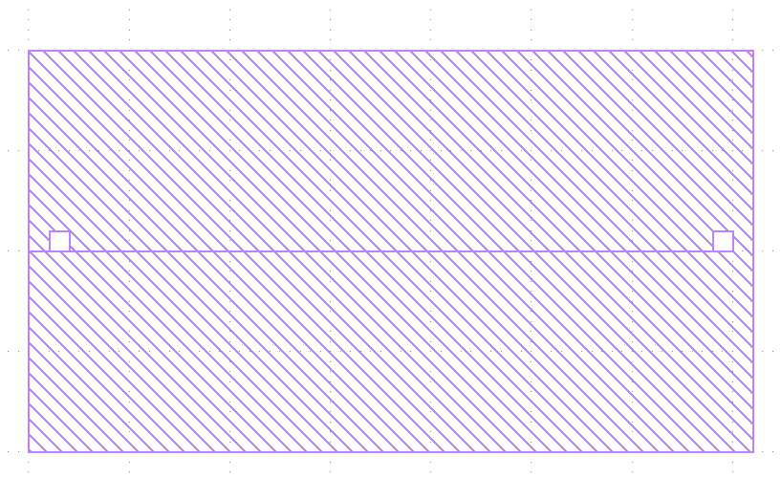
Layout Top View
Masks 1:- Negative Photoresist/ Liftoff
Masks 2:- Negative Photoresist/ Liftoff
Top View of Masks
Masks 3:- Positive Photoresist/ Etching
Masks 4:- Positive Photoresist/ Etching

Slide 8
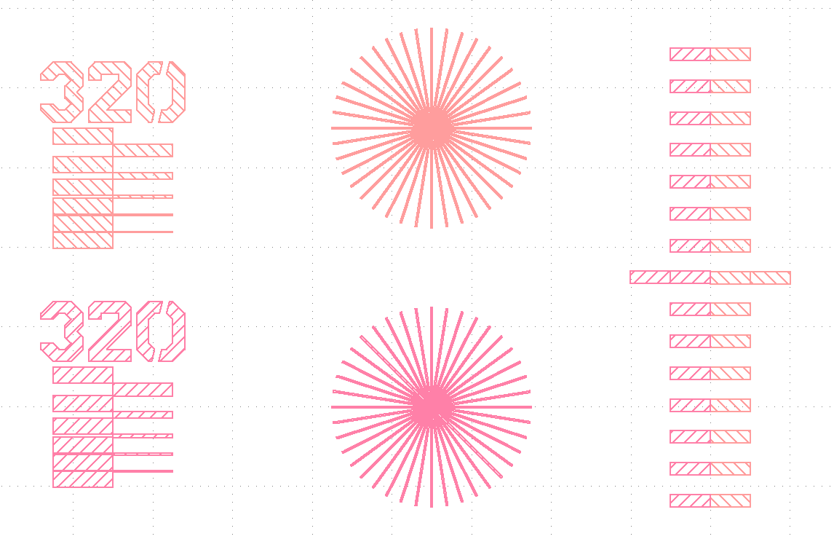
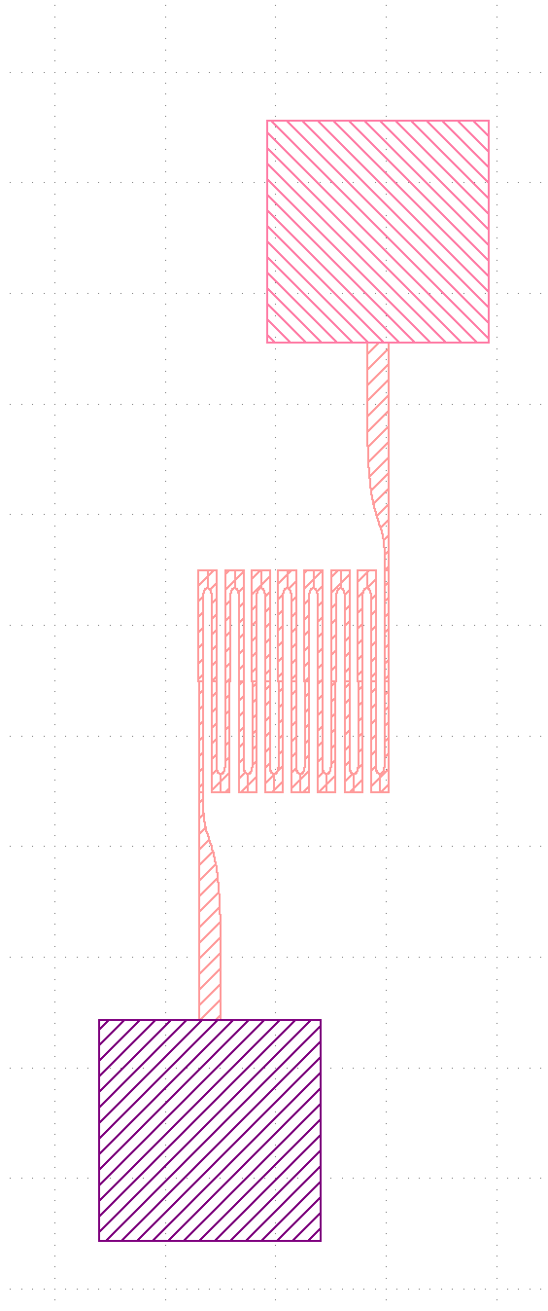
Test Structures

